Slide 1


Slide 2

Compatibility testing

Slide 3

Compatibility
Compatibility is nothing but the capability of existing or living together. In normal life, Oil is not compatible with water, but milk can be easily combined with water

Slide 4
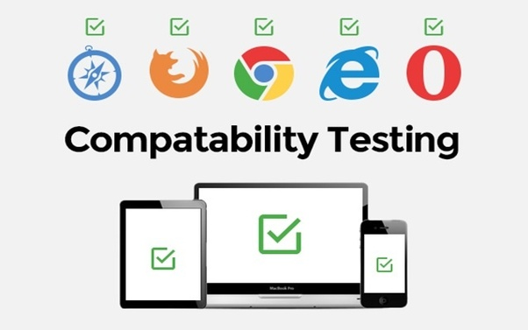
Compatibility Testing
Compatibility Testing is a type of Software testing to check whether your software is capable of running on different hardware, operating systems, applications, network environments or Mobile devices.

Slide 5
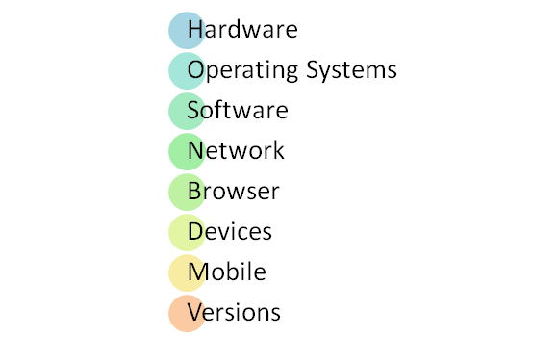
Types of Compatibility Tests

